Slide 1
Modelling: Sci-fi Silo
Taylor Raine - 25156239

Slide 2
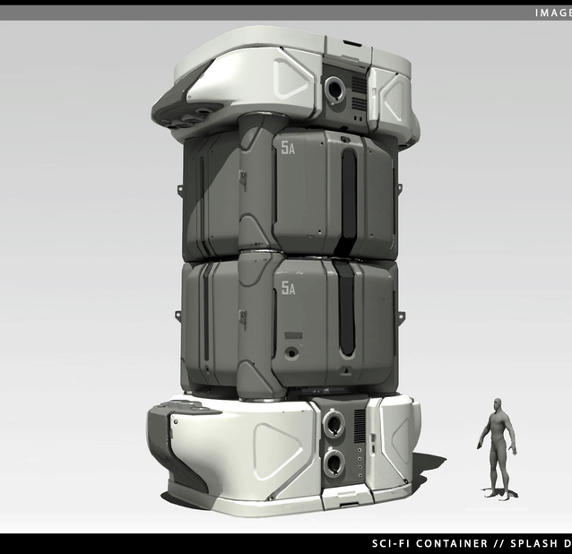
Intro
My names taylor raine and For this assignment, I was given the goal of recreating this Sci-Fi style storage silo.
Originally design by splash damage.

Slide 3
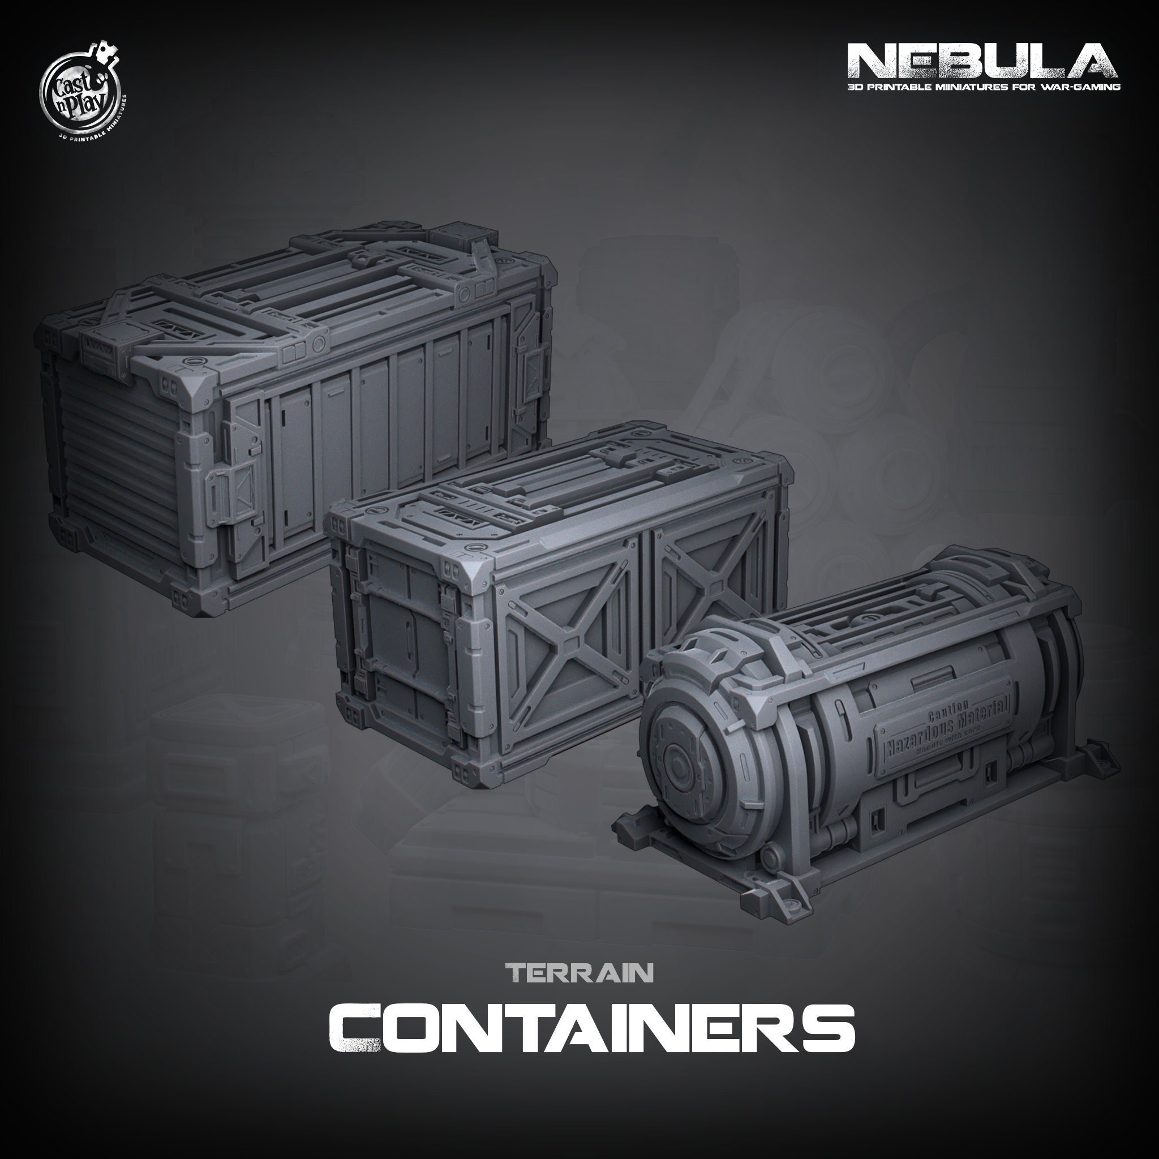
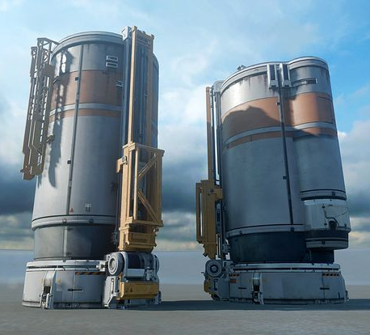
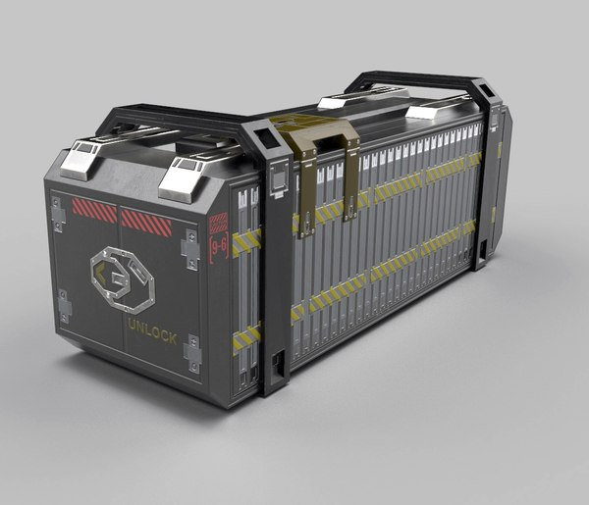
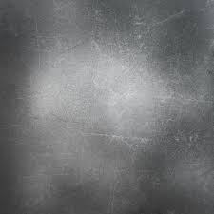
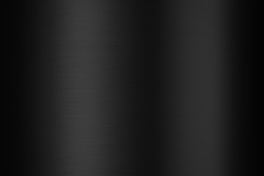
Mood board

Slide 4
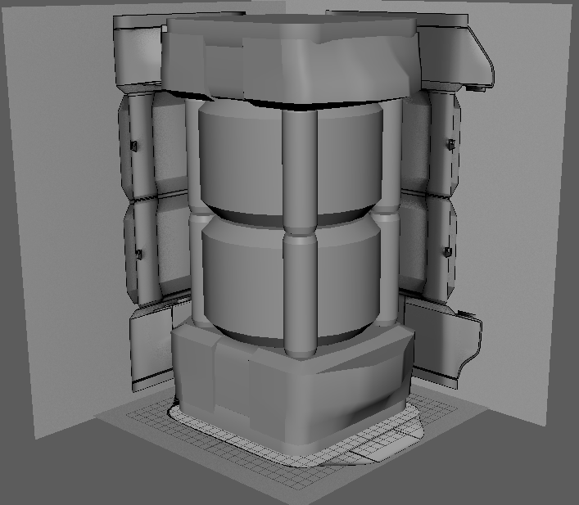
Block out
To start I created a simple block out to correctly set the scale and position of each part

Slide 5
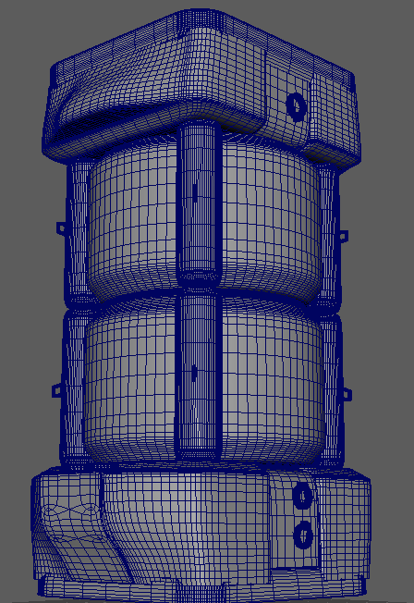
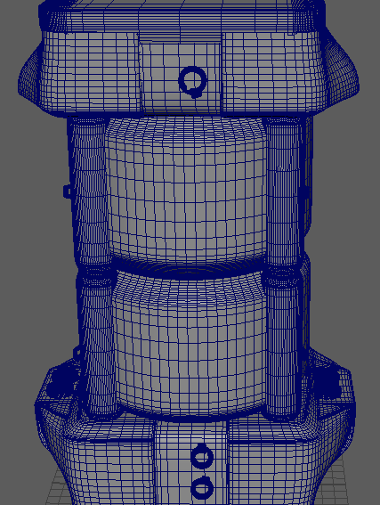
High Poly
Using the Block out as a base I designed the high poly version of my silo.
matching the curvature and small details to that of the reference

Slide 6
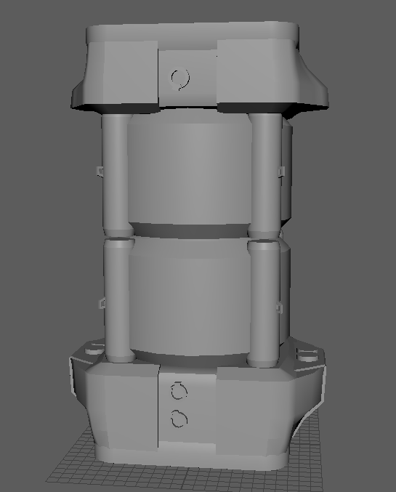
Low Poly
From my high poly, I made the low poly by removing all the unnecessary edges and vertices, being careful to remove all N-gons while keeping the silhouette intact.
I also assigned ID materials to each part of the Model.

Slide 7
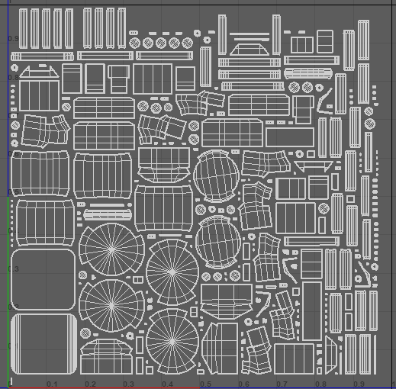
UV’s
Then using mays auto UV tools, I made a simple UV map of my model

Slide 8
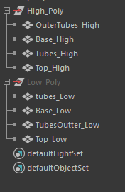
Naming Scheme
Before carrying on I made sure that both my high and low poly followed a naming scheme, with both having a relative describer at the end. E.G _Low

Slide 9
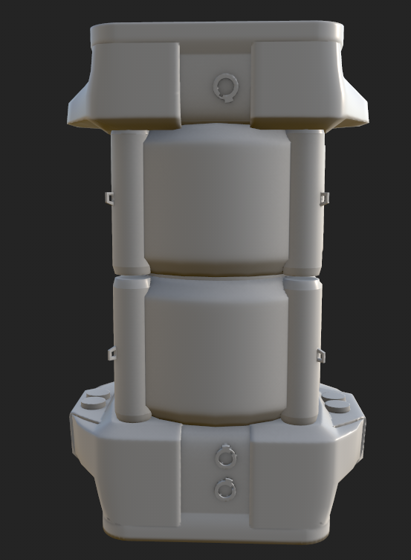
Baking the Model
I then used substance painter to bake the high polys details onto the low poly model

Slide 10

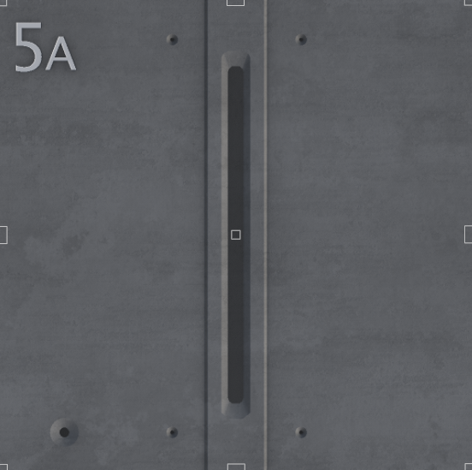
Trim Sheets
For the Textures of my Silo, I decide to try out some trim sheets for the parts with more unique details.

Slide 11
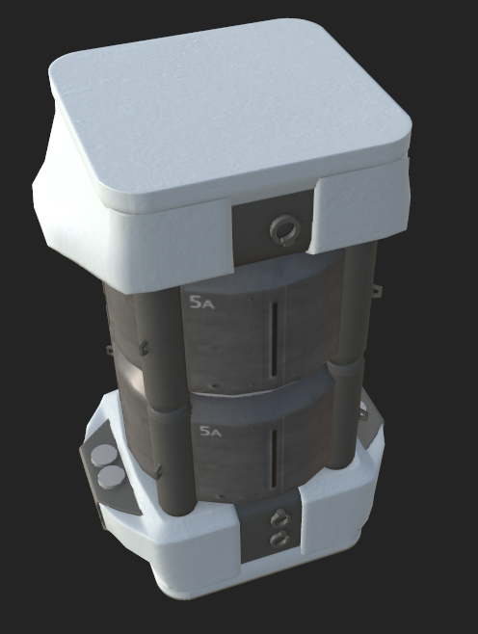
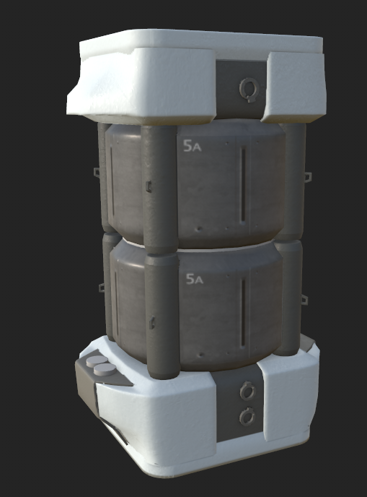
Texturing
Continuing in substance painter I used the trim sheets I had just made to apply the textures

Slide 12
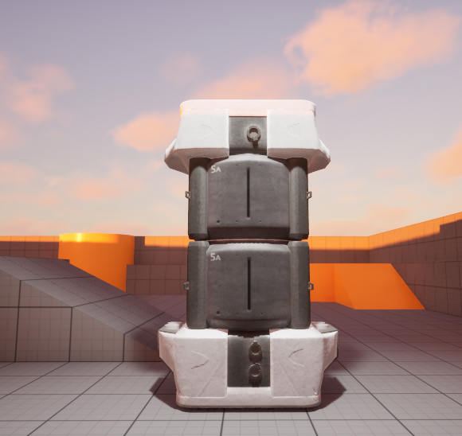
Unreal Render
With the silo now texture I imported it into Unreal engine and created a high-Resolution screen shot

Slide 13
Redesign
Looking at my final version, I realised I wasn’t very pleased with the final look, so I decided to redo most of the texturing process to make an improved final look.
Starting with a new UV layout.

Slide 14
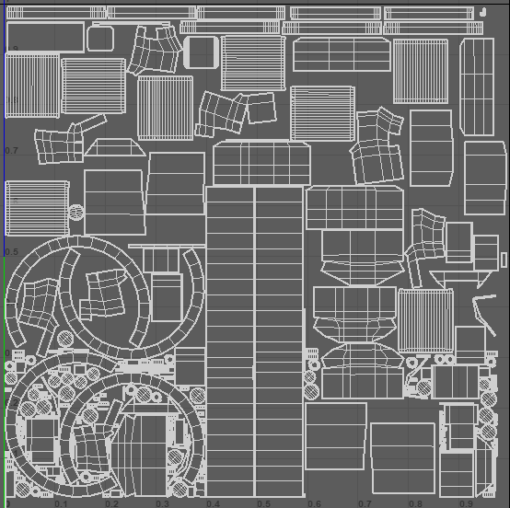
Corrected UV’s
Returning to Maya I looked at each part of the asset, sewing and cutting edges to make a better layout

Slide 15
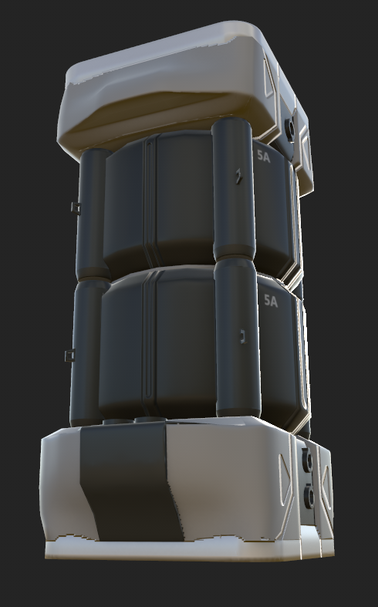
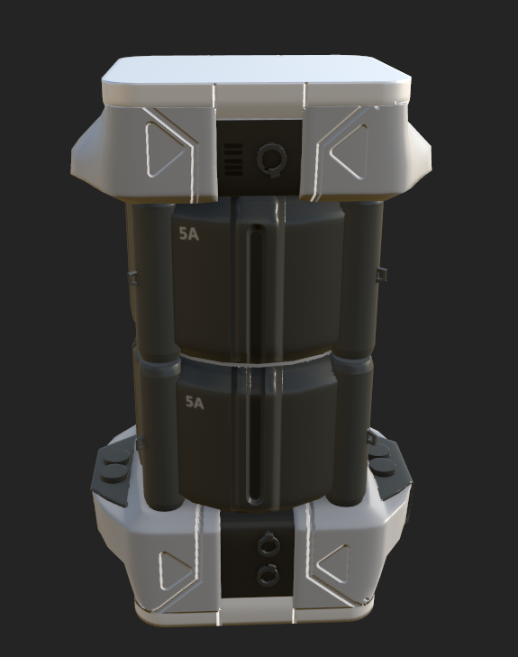
Re Texture
With these new UV’s I quickly re-baked the model.
I also decided to use substance painters painting features with a black mask to add the high maps and more precise colours.
I also changed the material to be more metalic

Slide 16
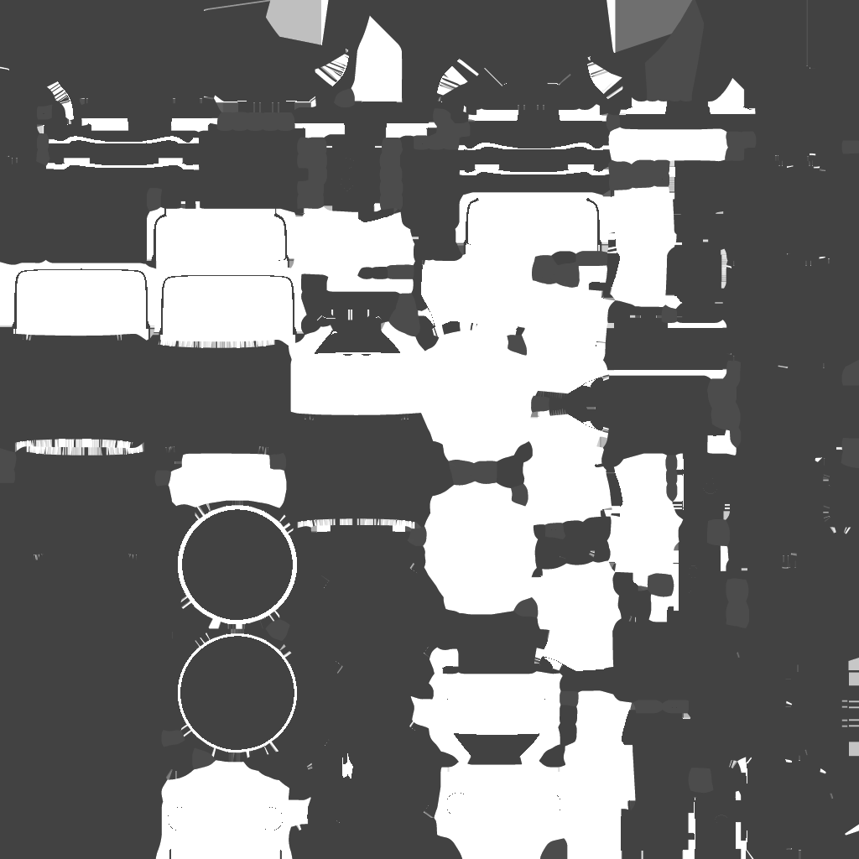
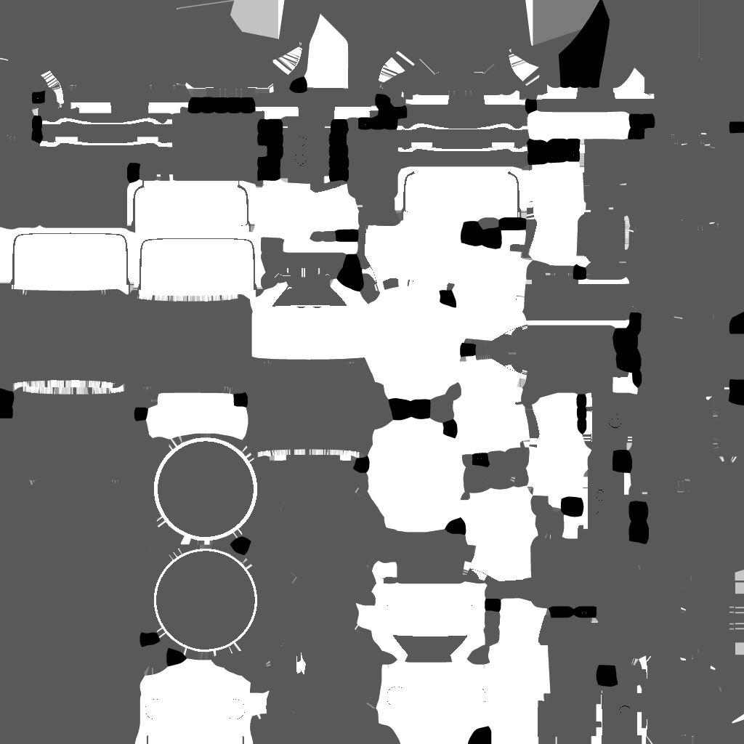
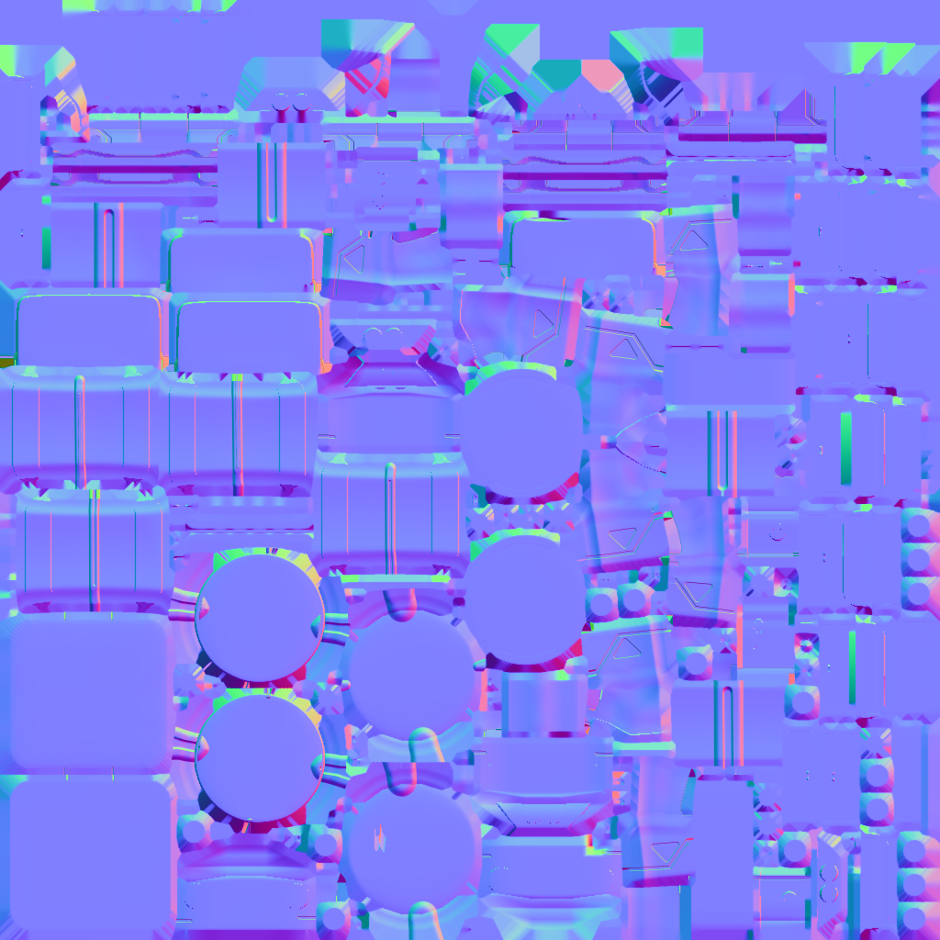
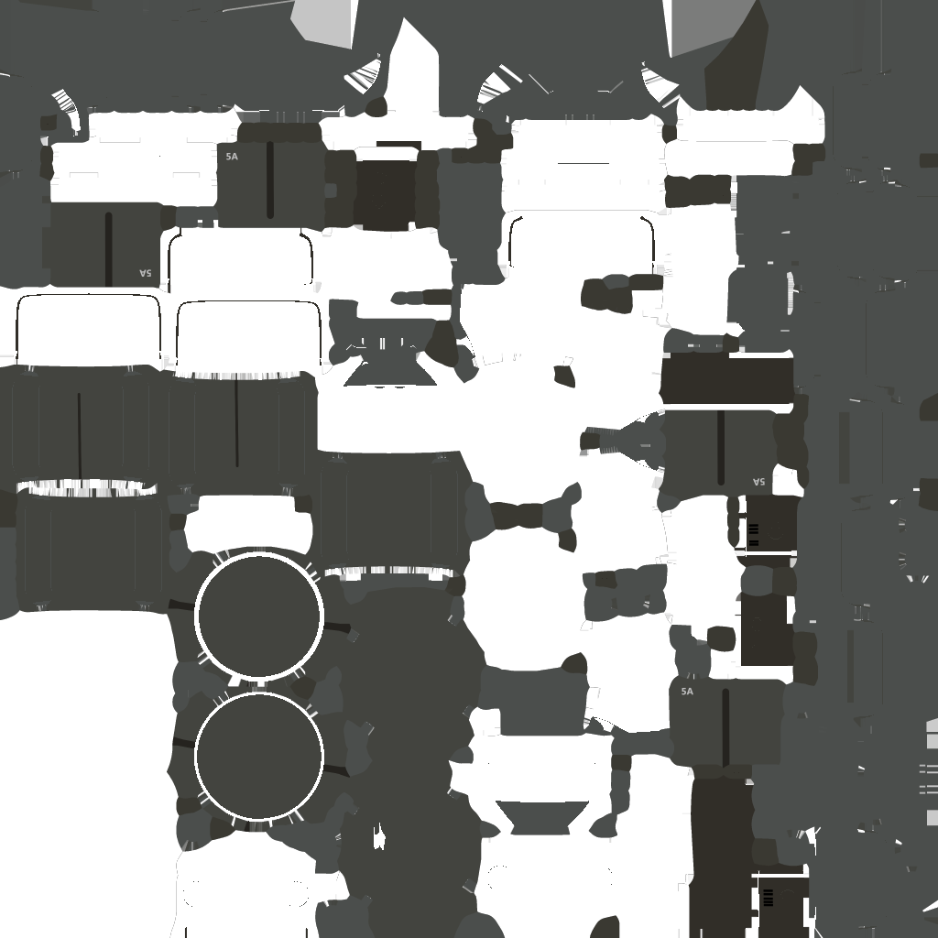
Texture maps
Roughness
Metallic
Normals
Base Colour

Slide 17
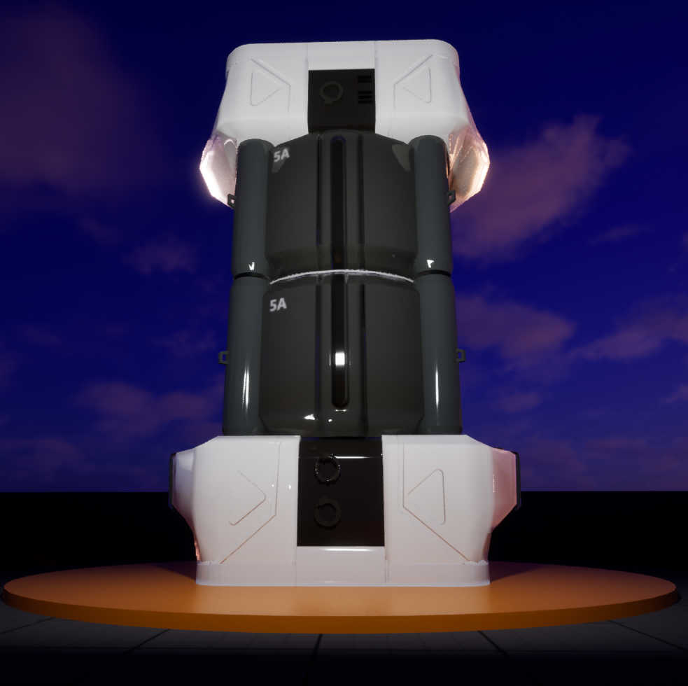
Final Verisoin

Slide 18
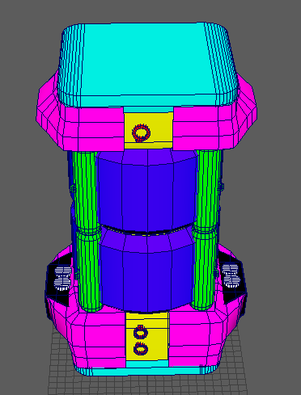
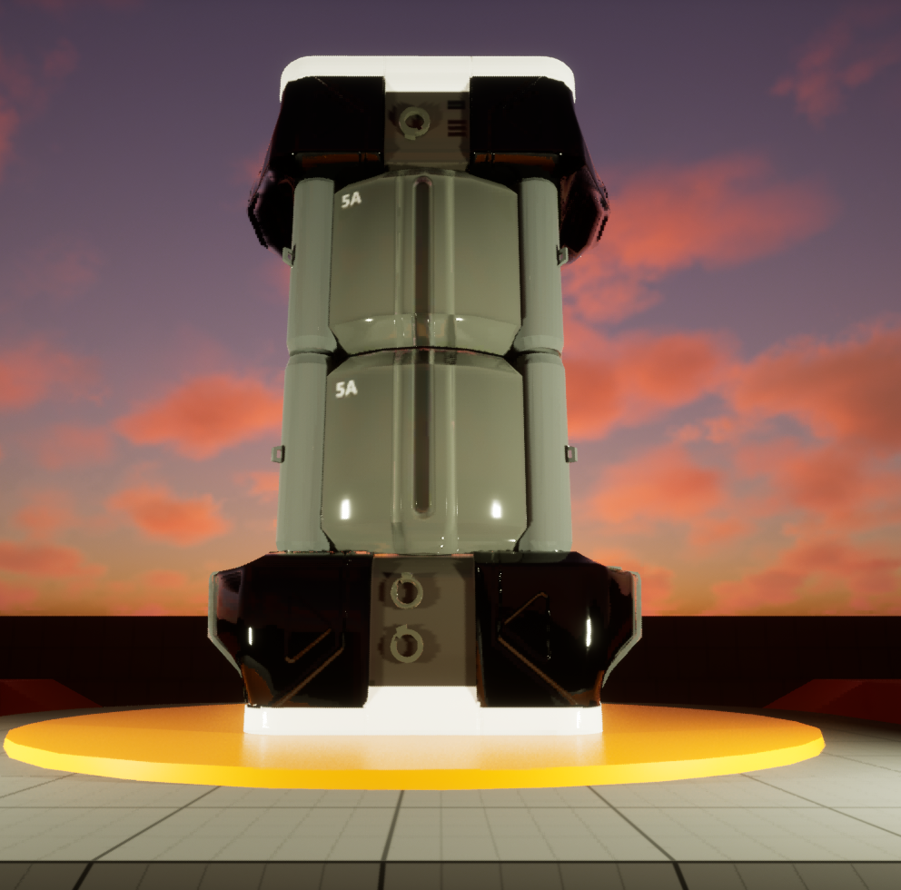
Time line
Block Out
High Poly
Low Poly
1st UV
2nd Texture
1st Render
Final Version
2nd UV

Slide 19
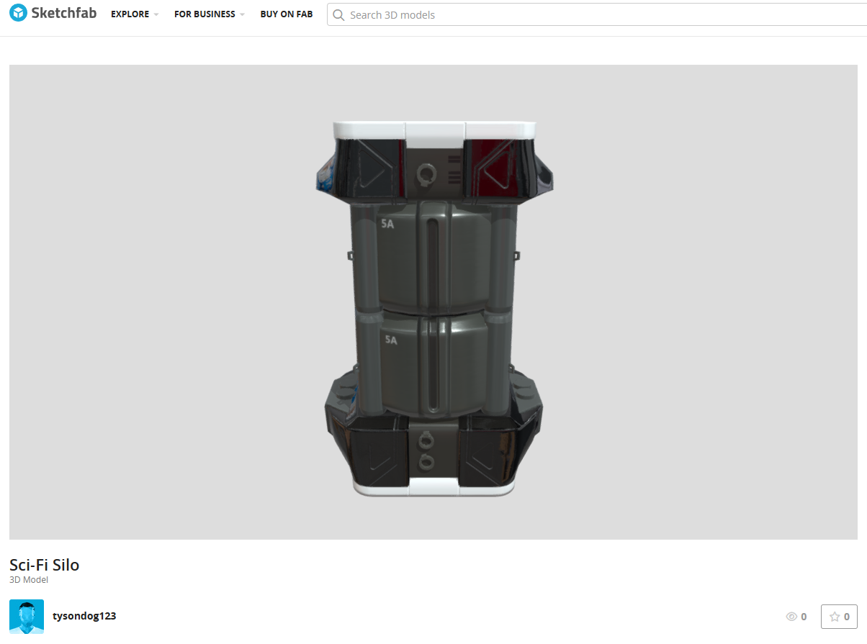
Sketch Fab
https://skfb.ly/pJn8O

